Slide 1

Restaurant Management

Slide 2

Introduction
Full stack Application – Restaurant Management (Veg Chillies)
A Restaurant Management System is an application that is designed for managing the functioning of restaurants. To keep records of all the types of restaurants.
The basic functions like new restaurants can be added, all the records of the restaurants can be viewed and also can be updated if any changes in to the restaurant.

Slide 3

Technologies Used
Web Technologies
- HTML, CSS, Node JS and Java
Framework
- Angular JS, Spring Boot
Database
RDBMS database and MySQL
Other
- Hibernate, JPA

Slide 4
The Architecture of the project
FrontEnd
Angular JS
Node JS
Controller
Spring Boot
Hibernate
BackEnd
MySQL

Slide 5
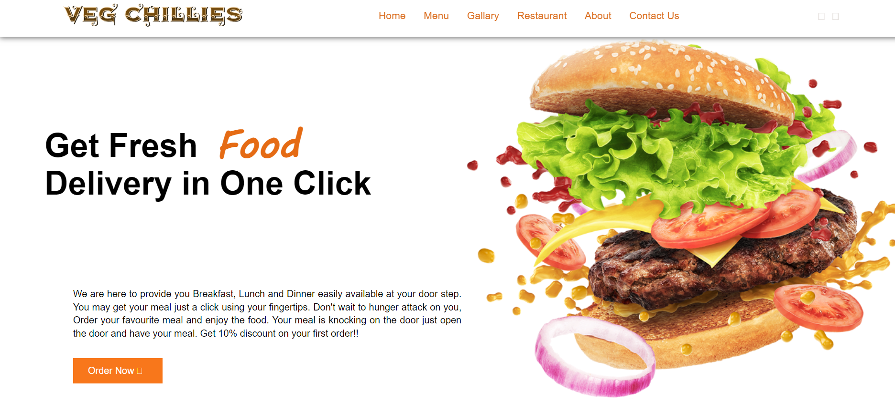
Home Page

Slide 6
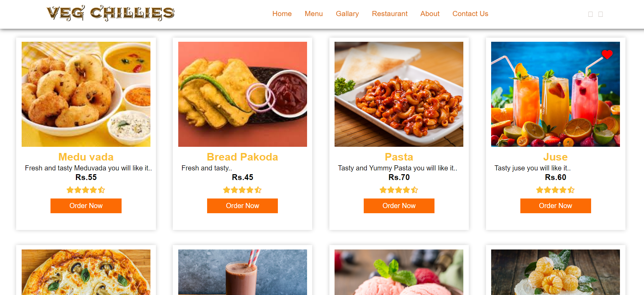
Menu Page

Slide 7
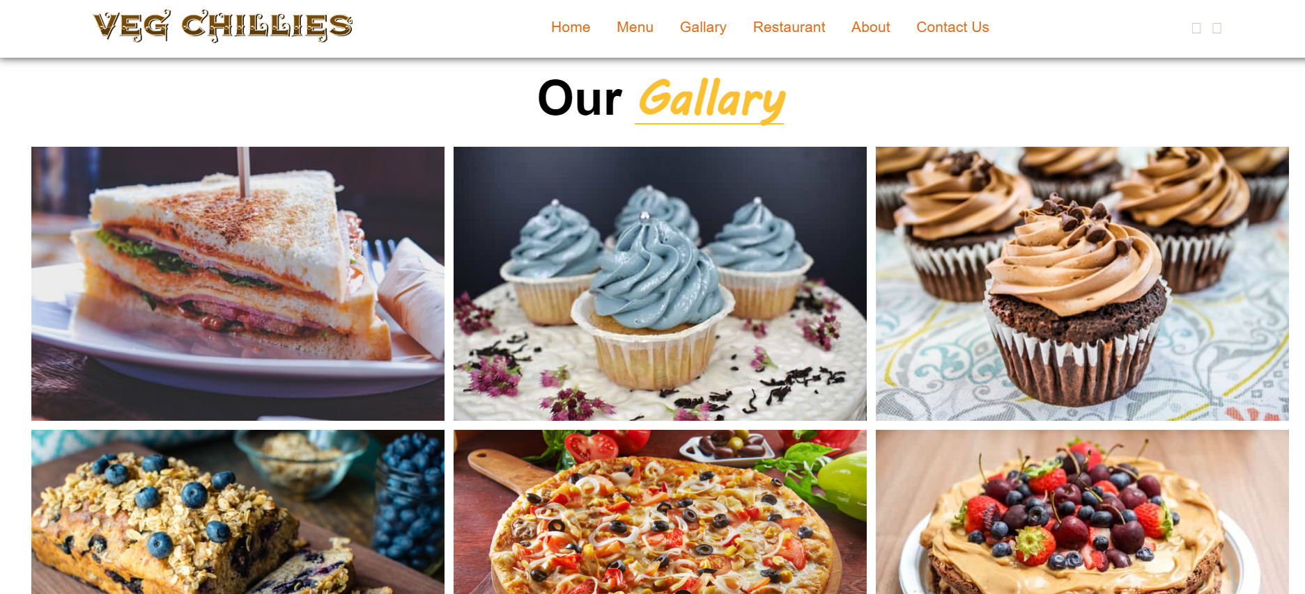
Gallary Page

Slide 8
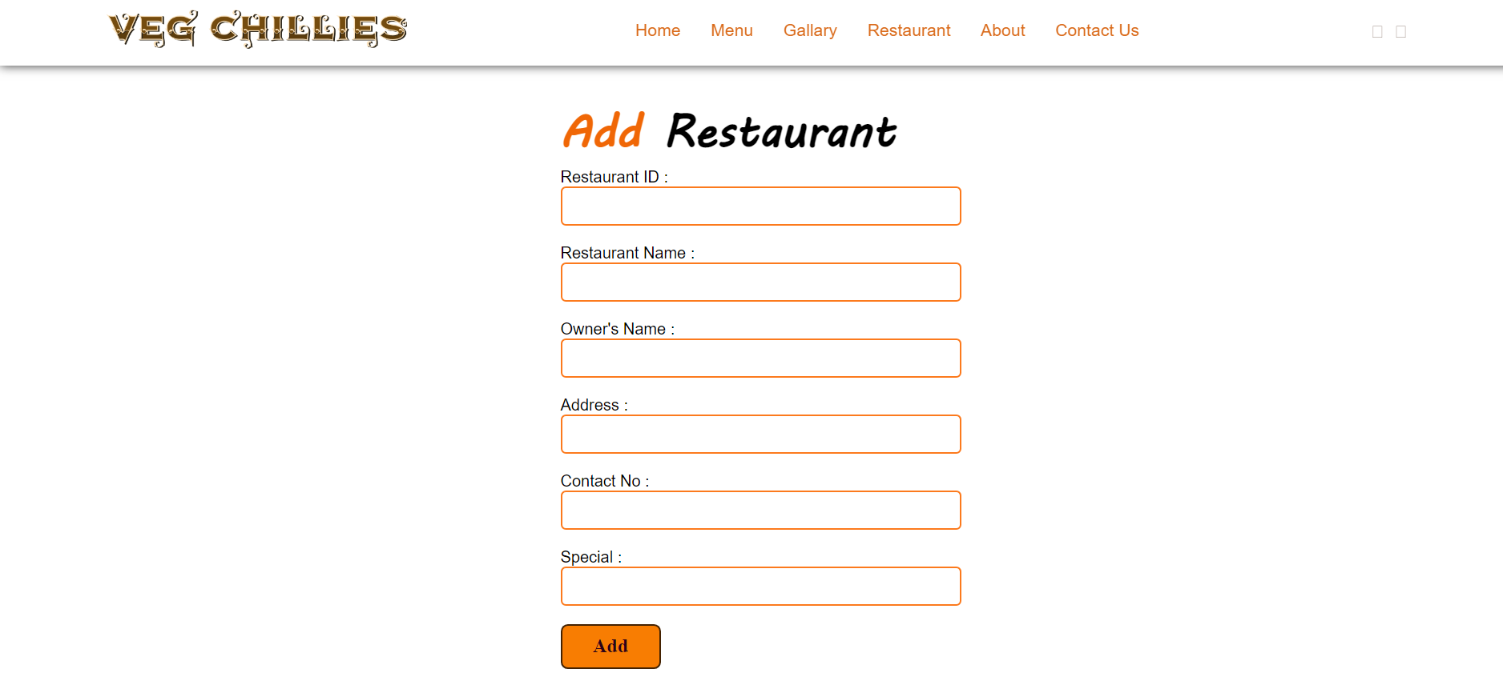
Add Restaurant

Slide 9
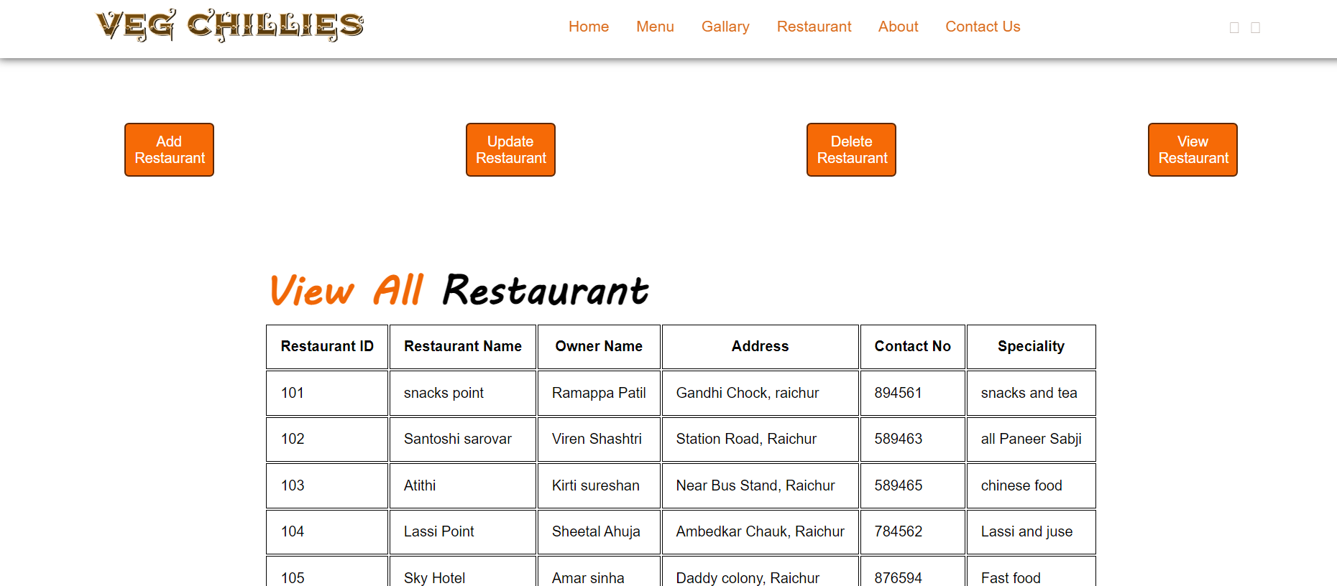
View Restaurant

Slide 10
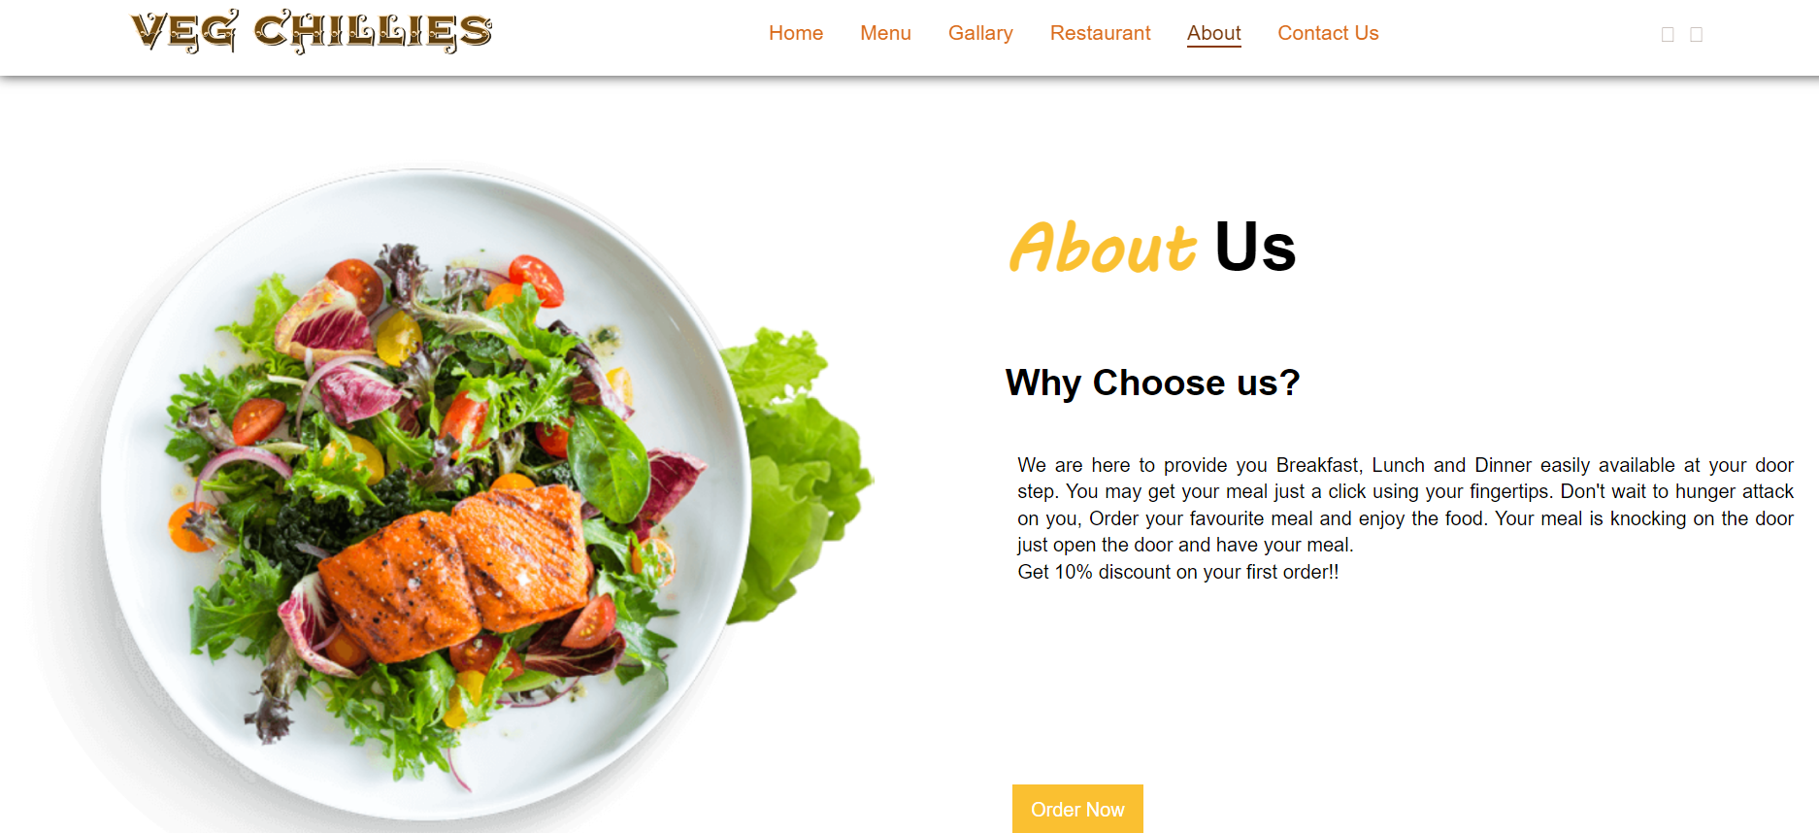
About Us

Slide 11
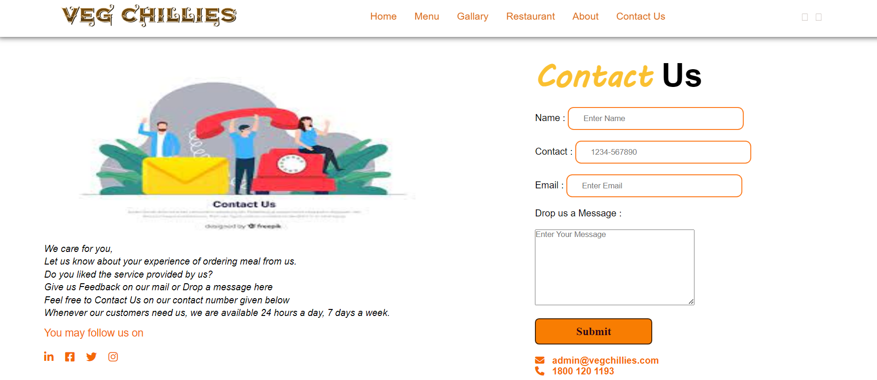
Contact Us

Slide 12
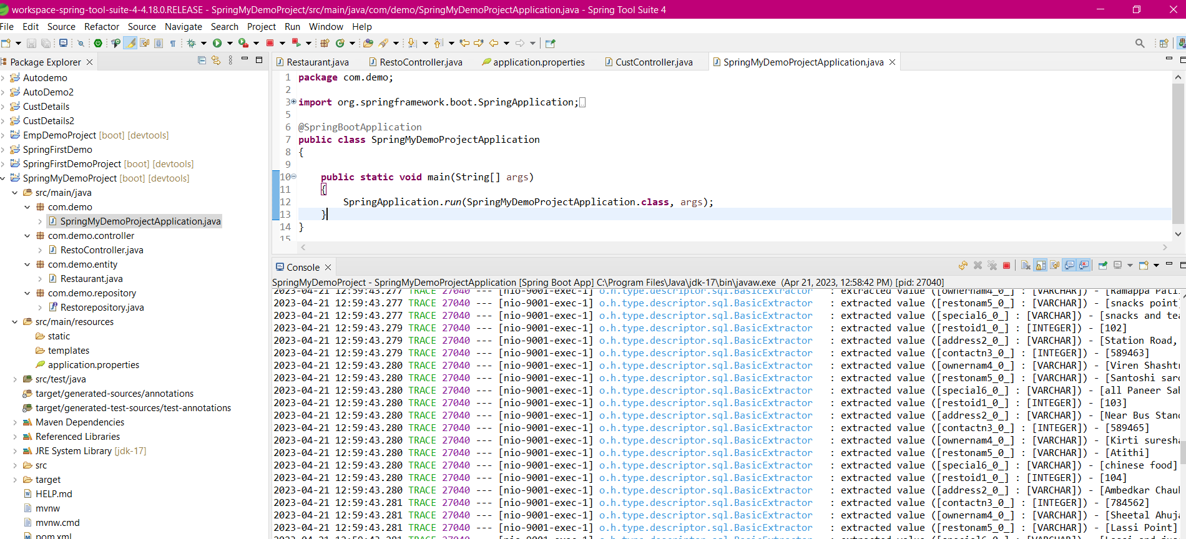
Spring Application

Slide 13
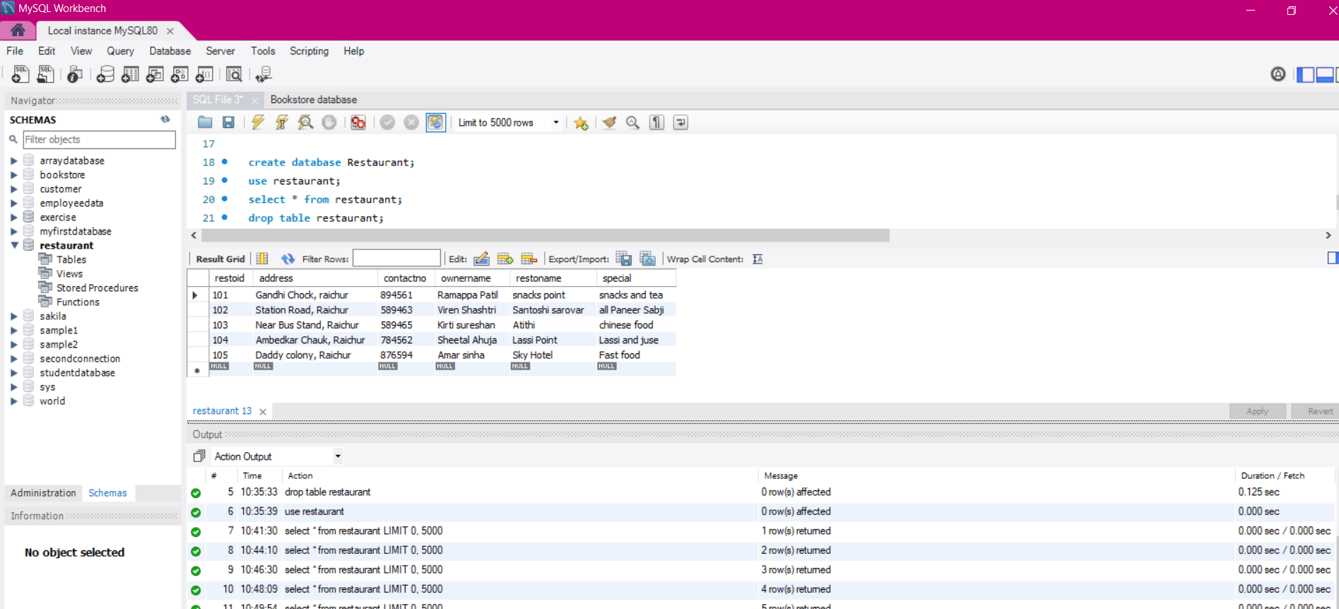
MySQL

Slide 14
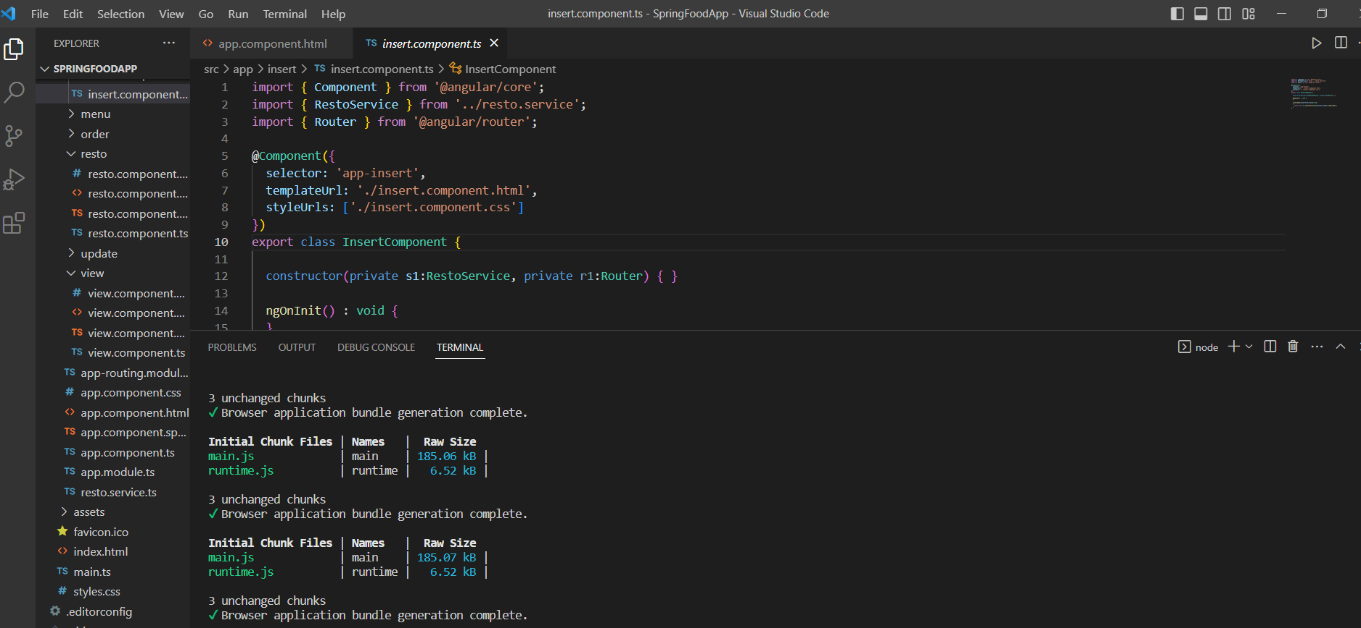
Angular Application

Slide 15

Future Scope
Login authorization
Addition of crud services to food
Modified as Food Ordering Application

Slide 16

Git-hub Link

Slide 17

Thank you

